Slide 1
UV QR Code Trial
120629

Slide 2
Background
The latest near UV and UVA QR code samples provided by Will Merrill were evaluated with an iPhone 4 camera on a white piece of paper
Additional devices will be evaluated at a later time
365nm UV LEDs were used to evaluate the visibility of the QR codes to the phone’s camera with a UV source
The spectral output of these LEDs need to be determined

Slide 3
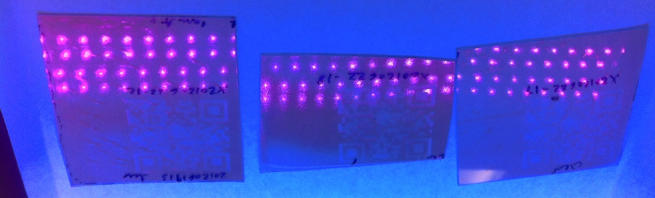
Under 365nm LED UV Source on White Paper
The contrast of all three samples was good with a UV source.

Slide 4
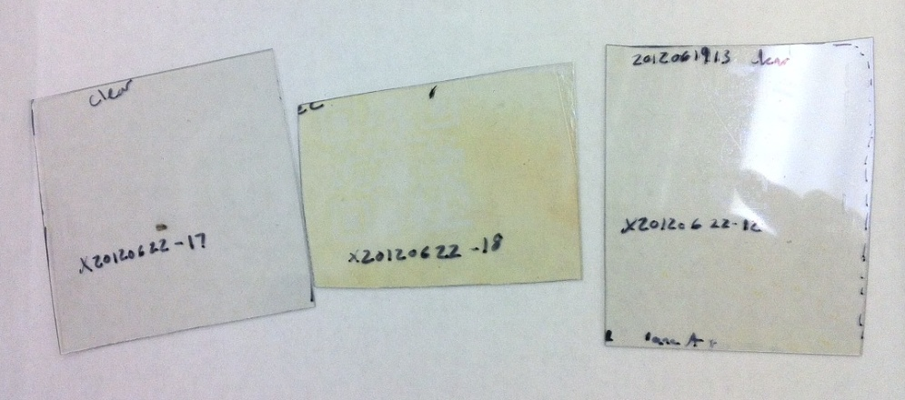
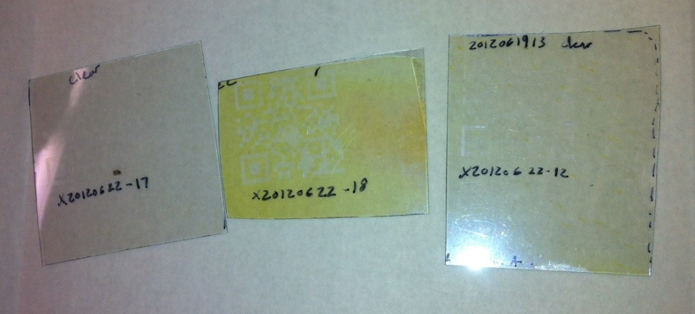
iPhone 4 Camera Visibility With and Without Flash
Without Flash on White Paper
With Flash on White Paper
With the white fluorescent lab lighting, sample 18 had a slight yellow hue to it and the QR code was more visible than on samples 17 or 12. When the camera flash is utilized, the specular reflection of the blue wavelengths makes sample 18 appear very yellow, but the QR codes remain difficult to see in samples 17 and 12.

Slide 5
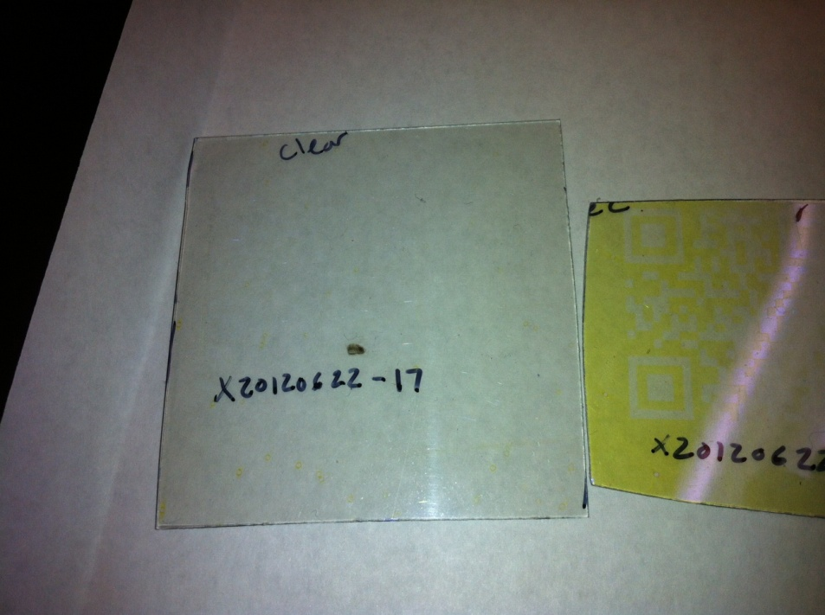
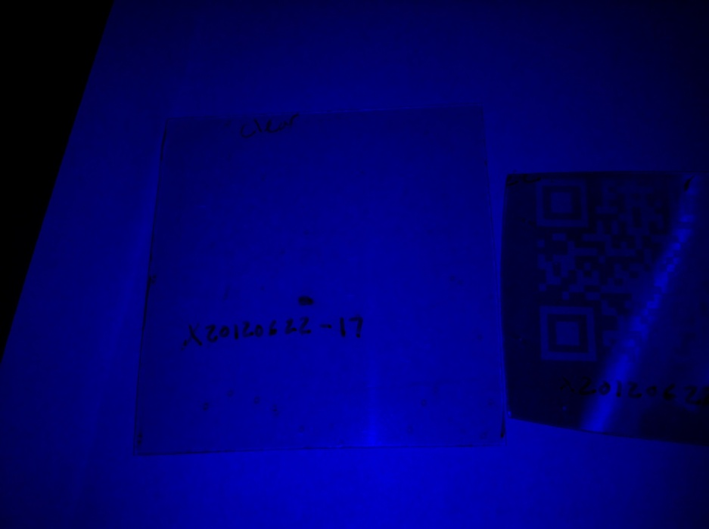
Color Image vs. Blue Channel Only of Sample 17
Color Image
Blue Channel Only
With the blue channel only, there is no significant contrast enhancement for sample 17.

Slide 6
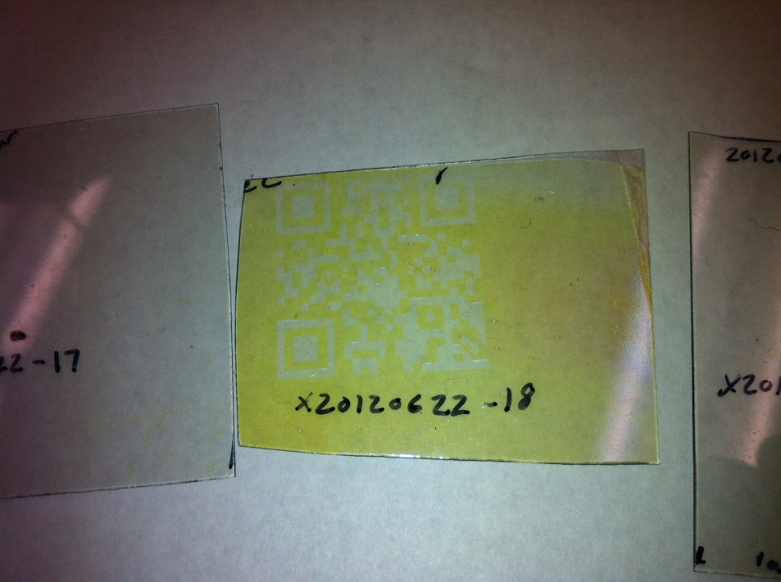
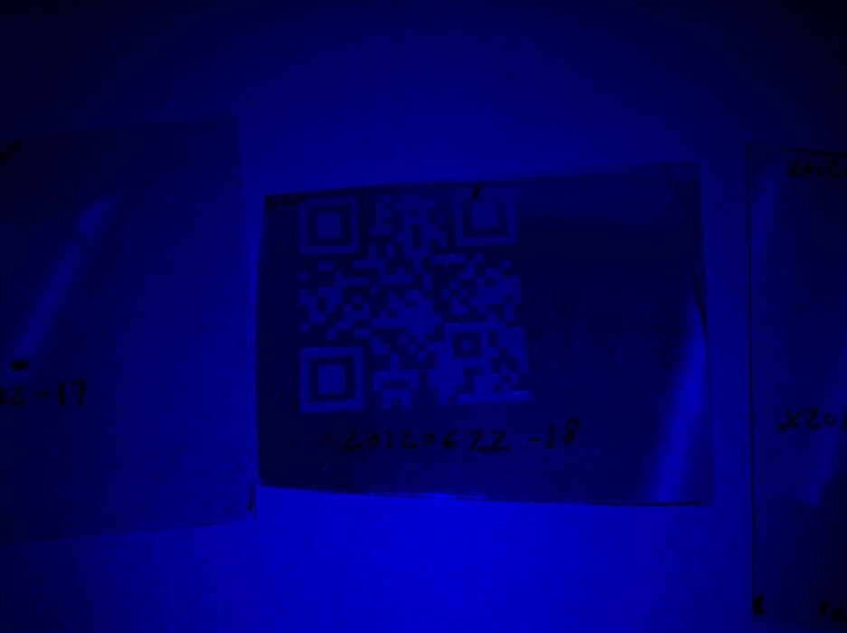
Color Image vs. Blue Channel Only of Sample 18
Color Image
Blue Channel Only
With the blue channel only, there is significant contrast enhancement for sample 18.

Slide 7
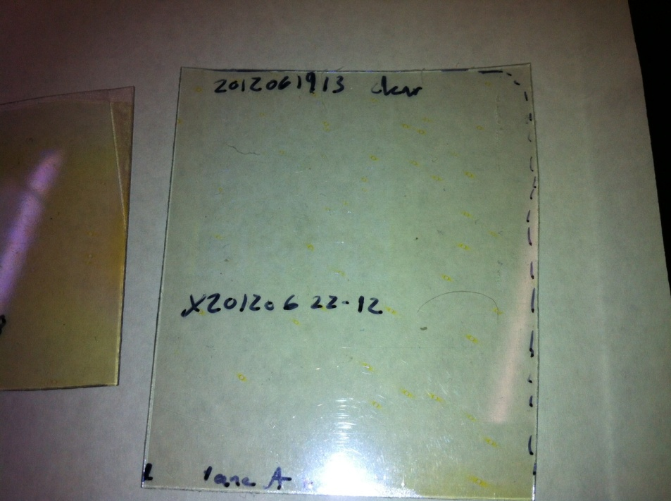
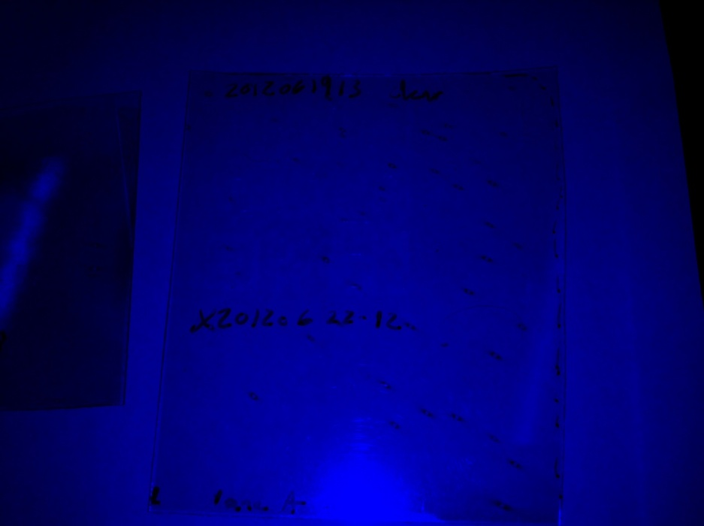
Color Image vs. Blue Channel Only of Sample 12
Color Image
Blue Channel Only
With the blue channel only, there is light contrast enhancement for sample 12.

Slide 8
Conclusions and Next Steps
The contrast is much greater if the wavelength rejection extends significantly into the blue channel detector’s spectrum
Evaluation of these samples with additional mobile devices will be conducted
Determine a test method to evaluate the blue channel wavelength range and sensitivity for a variety of mobile phone cameras
The first attempt will utilize the exit port on the Lamda 900 and a diffuse reflectance standard. The mobile phone camera will image the spot on the standard as the wavelength is altered to understand the lower detection limit and upper limit for the blue channel.

